Slide 1
Symmetric & Asymmetric encryption
Cryptography and Network Security
Presented by
Prantik Kumar Patra

Slide 2

SYMMETRIC ENCRYPTION
An encryption system in which the sender and receiver of a message share a single, common key that is used to encrypt and decrypt the message.
In other terms, Data is encrypted and decrypted using the same key.
Symmetric-key cryptography is sometimes called secret- key cryptography.

Slide 3








SYMMETRIC ENCRYPTION (cont..)
(Plain text)
(Plain text)
Hello world
Hello world
(cipher text)
#%giuyrwkmns:{?
Encryption
Decryption
Shared same secret key

Slide 4

Symmetric-key systems are simpler and faster, but their main drawback is that the two parties must somehow exchange the key in a secure way. Public-key encryption avoids this problem because the public key can be distributed in a non-secure way, and the private key is never transmitted, Public-key encryption avoids this problem because the public key can be distributed in a non-secure way, and the private key is never transmitted.
Examples of symmetric algorithms are DES, 3DES and
AES

Slide 5
MERITS & DE-MERITS
Merits:
SIMPLER
FASTER
De-Merits:
Two parties must somehow exchange the key in a secure way.
Public key is distributed in a non-secure way b/n Client/Server.
Easy for hackers to get the key as it is shared in unsecure way.

Slide 6
Asymmetric encryption:
Asymmetric encryption use two keys, one to encrypt the data, and another key to decrypt the data. These keys are generated together. One is named as Public key and is distributed freely. The other is named as Private Key and it is kept hidden.
Both Sender & Recipient has to share their Public Keys for Encryption and has to use their Private Keys for Decryption.

Slide 7
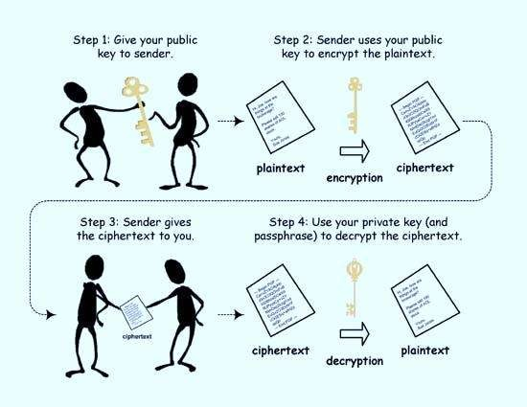
How it WORKS…….?

Slide 8
Key Points in Asymmetric Encryption
Asymmetric encryption use two keys:
Public Key - to encrypt the data Private Key - to decrypt the data
These keys are generated together.
The Public key(s) is distributed freely between the sender and receiver.
The other is named as Private Key and it is kept hidden.
The Private Key is only used for Decryption and will not be shared between the sender and receiver.

Slide 9
MERITS & DE-MERITS
Merits:
Two parties don't need to have their private keys already shared in order to communicate using encryption.
Authentication and Non-Repudiation are possible. (Authentication means that you can encrypt the message with my public key and only I can decrypt it with my private key. Non-repudiation means that you can "sign" the message with your private key and I can verify that it came from you with your public key.)
De-Merits:
Asymmetric Encryption algorithms are comparatively complex.
Time consuming process for Encryption and Decryption.

Slide 10
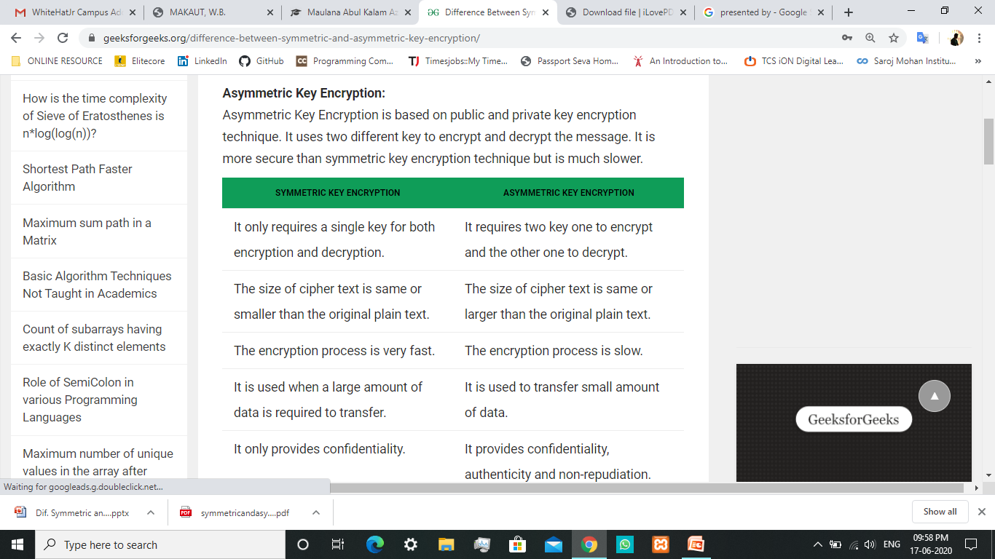
Difference Between Symmetric and Asymmetric Key Encryption

